Slide 1
DAA Assignment Presentation on the following topics: 1. Dynamic Programming 2. Greedy Algorithm 3. Divide and Conquer 4. Backtracking 5. Branch and Bound
PowerPoint presentation and codes prepared by:
Beeta Samad, 181210016 Ritika Singh, 181210042

Slide 2
Dynamic Programming

Slide 3
Introduction
Dynamic programming is both a mathematical optimization method and a computer programming method. In both contexts it refers to simplifying a complicated problem by breaking it down into simpler sub-problems in a recursive manner.

Slide 4
Introduction
There are two key attributes that a problem must have in order for dynamic programming to be applicable : optimal substructure and overlapping sub-problems. If a problem can be solved by combining optimal solutions to non-overlapping sub-problems, the strategy is called "divide and conquer" instead.

Slide 5
Introduction
Dynamic Programming follows “Principle of Optimality”.
Principle of Optimality : According to this, we take a number of decisions instead of taking one decision, at different stages to solve a problem.

Slide 6
Introduction
The basic difference between Greedy Algorithm and Dynamic Programming is that, in greedy approach we make one decision to be followed at all steps. While in dynamic programming approach we have a sequence of decisions at certain stages and followed, to get the optimal solution.

Slide 7
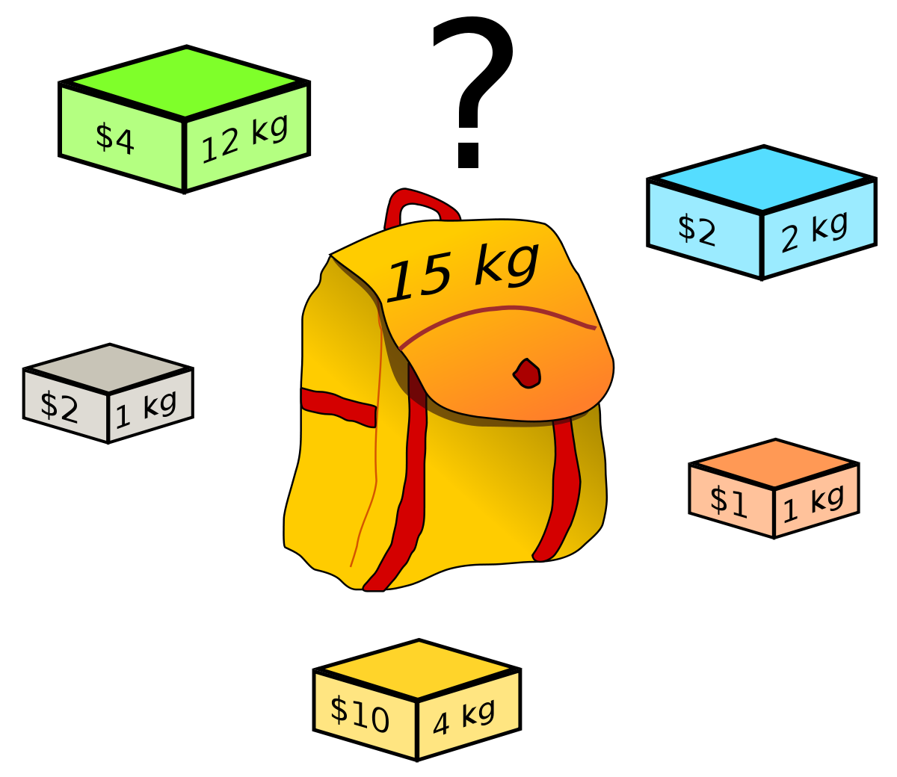
Real Life Application
PROBLEM STATEMENT :
We are given weights and profit values of n items. Along with a knapsack of weight let’s say m units, to carry these items. We are required to fill the knapsack in such a way that, the complete weight of the knapsack is utilized with maximum profit.
Constraints : You cannot break any item. You can either pick the complete element or don’t pick
(0-1 property).

Slide 8
Basic Idea
A simple solution is to consider all subsets of items and calculate the total weight and value of all subsets. Consider the only subsets whose total weight is smaller than W. From all such subsets, pick the subset that gives the maximum profit to us.
And that would be the most optimal solution for the following problem. Note that, unlike Greedy Approach we will be making choices at each step to either select the subset or not and later choosing the most feasible option out of it.

Slide 9
Solution
As per the basic ideology, this optimization problem can be solved in two ways :
• Tabular Method : Create a table that contains the information of
maximum profit gained from choosing the particular object.
• Sets Method : Create sets containing ordered pairs of (profit,
weight) that give the information about profit gained from
choosing the particular object.
We proceed with the first method to solve this problem dynamically.

Slide 10
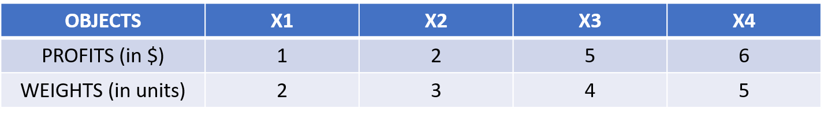
Solution
Consider the following information for the given problem :
Total number of objects : 4 Maximum size limit of Knapsack : 8 units
Construction of the Table :
STEP I : First we create a table of number of rows same as the max weight of
the knapsack, and columns same as the number of objects.

Slide 11
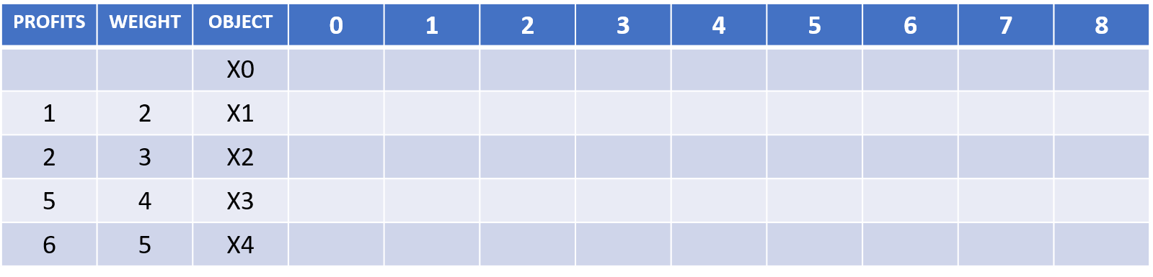
Solution
STEP II : Now we start filling the table. Criteria to fill the table is as given below :
When the object selected and weight selected is zero, then the corresponding profit for that object is also zero. And this fills up the first row and first column as shown in the next slide.

Slide 12
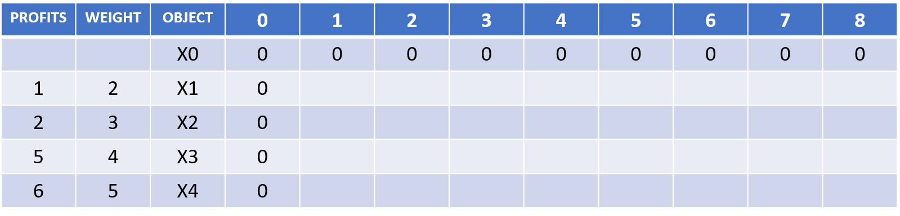
Solution

Slide 13
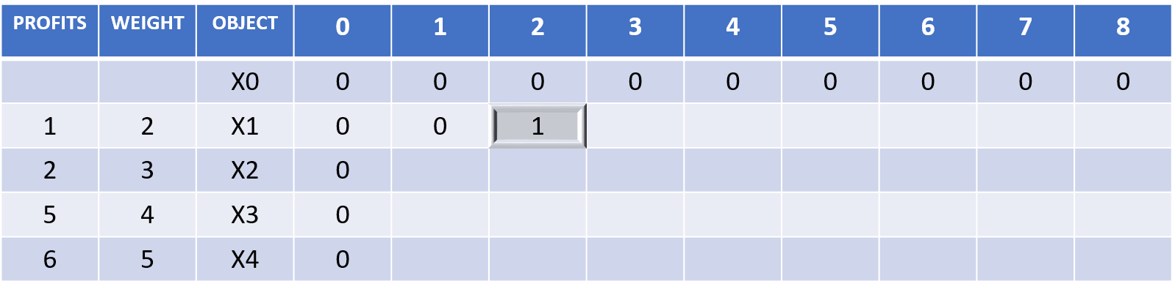
Solution
STEP III : The highlighted cell represents that we have selected the first object of weight = 2 and profit = 1. Thus if only the first object is selected then the profit will be 1 and the weight occupied will be 2. (NOTE : All the cells before it will be filled by the same previous value.
Similarly fill the rest of the tables, by analyzing the weight occupied and the profit gained.

Slide 14
Solution
The formula to fill this corresponding table in the tabular method is as given below :
V[i, w] = max{ V[i-1, w], V[i-1, w-w(i)] + P[i] }

Slide 15
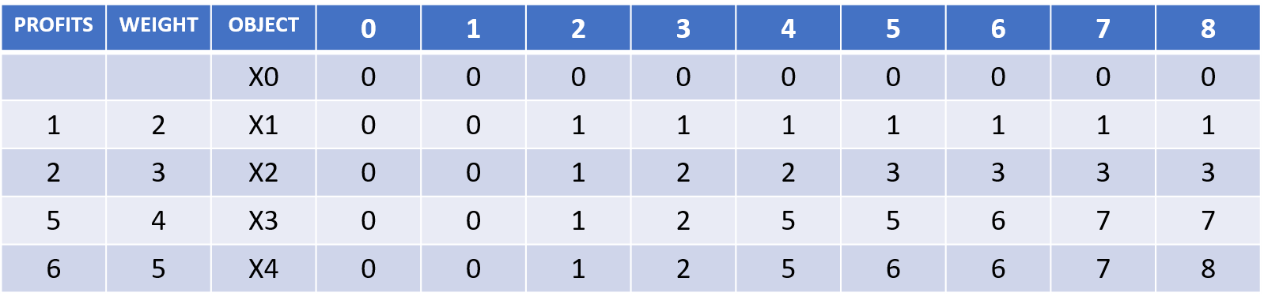
Solution
Using the formula we get the final table as :

Slide 16
Solution
Making sequence of decisions :
STEP I : Begin with the cell with maximum profit value. And check if that value
is present in any of the previous cells or rows.
If NO, then that particular object is selected, completely.
If YES, then keep looking for the row where the particular occurs first time and include the object, completely.

Slide 17
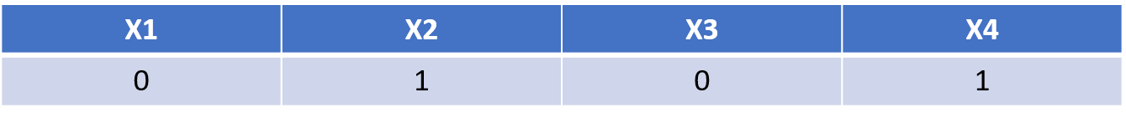
Solution
On following the above step, we get the following result as our optimal selection of objects:
where 0 and 1 indicate whether the object is selected completely or not.

Slide 18
Algorithm
INTEGER-KNAPSACK(W, V, e)
T<-MAKE-ARRAY(length[V], e)
for i<-0 to length [V]
do T[i,0] = 0
for j<-0 to e
do T[0, i] = 0
for i<-1 to length [V]
for j<-1 to e
if j-wi < 0
then T[i, j] = T[i-1, j]
else
T[i, j] = max (T[i-1, j], vi + T[i-1, j-wi])

Slide 19
Time Complexity
Each entry of the table requires constant time O(1) for its computation.
It takes O(n*w) time to fill (n + 1)*(w + 1) entries in the table.
It takes O(n) time for tracing the solution since the tracing process traverses through n rows.
TOTAL TIME : O(n*w)

Slide 20
Greedy Algorithm

Slide 21
Introduction
A greedy algorithm is any algorithm that follows the problem-solving heuristic of making the locally optimal choice at each stage with the intent of finding a global optimum.

Slide 22
Introduction
In mathematical optimization, greedy algorithms optimally solve combinatorial problems having the properties of matroids, and give constant-factor approximations to optimization problems with submodular structure.

Slide 23
Introduction
In general, Greedy Algorithm has 5 important components :
1. A candidate set from which the solution set is created.
2. A selection function which chooses the best candidate set to be added to the solution.
3. A feasibility function which is used to if the candidate set chosen is feasible.
4. A objective function which assigns a value to the solution, or a partial solution.
5. A solution function which will indicate when we have discovered a complete solution.

Slide 24
Introduction
We design greedy algorithms according to the following sequence of steps :
1. Cast the optimization problem as one in which we make a choice and are left with one sub problem to solve.
2. Prove that there’s always an optimal solution to the original problem, that makes the greedy choice, so that the greedy choice is always safe.
3. Demonstrate optimal substructure by showing that, having made the greedy choice, what remains is a sub problem with a property that if we combine the optimal solution to the sub problem with the greedy choice that we have made, we arrive at an optimal solution to the original problem.

Slide 25
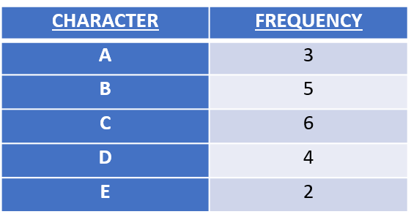
Real Life Application
PROBLEM STATEMENT
We have a 100,00 structure character data file that we wish to store compactly. We observe that the characters in the file occur with a frequency.
For an instance, consider the below given message
of 20 character sets, in which only 5 characters are
present.
Message : BCCABBDDAECCBBAEDDCC
And the frequency of each character present in the
message is as given :
We need to devise a method using which we can transfer or store the data as compactly as possible. In other words, formulate a method to compress the size of data.

Slide 26

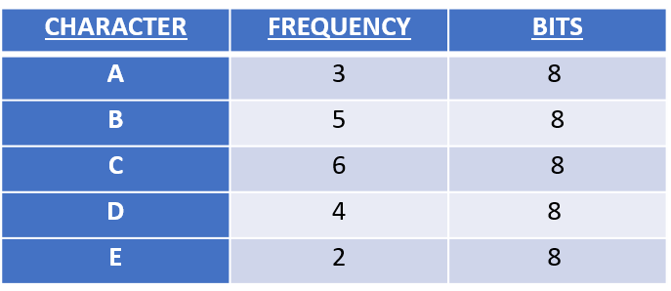
Real Life Application
Why, is data compression so important ?
Consider the following message to be stored (or transferred) :
Message : BCCABBDDAECCBBAEDDCC
The frequency table for each the above given character data set is :
We observe that if we use standard ASCII code to
represent each character in the data set, then the
total size of the message is 160 bits.
Can this size be reduced ? If ‘Yes’, then how ?
The answer is YES. The size of the above message
can be compressed, using either fixed-size code or
variable size code.
Total : 20
Total size : 160 bits

Slide 27
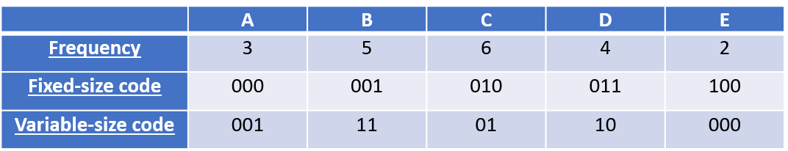
Real Life Application
Let’s understand how can the size occupancy be reduced by the above mentioned techniques :
As we can see, if we use fixed-size code, we are using 3 bits to represent each unique character in the message. And this method requires :
Size (occupied by the characters) : 3 (bits) * 20 (characters) = 60 bits.
(But, we are also required to store the table.)
FINAL SIZE = (SIZE OF MESSAGE + SIZE OF THE TABLE)
For the fixed-size code, we need to store 2 rows in the table. The character row and the fixed-size code row.
FINAL SIZE = 60 bits + 40 bits + 15 bits = 115 bits
The size of the message can be compressed even more, by using variable-size code method.
TOTAL SIZE = 45 bits + 40 bits + 12 bits = 97 bits

Slide 28
Real Life Application
We will be using the variable-size code method to get an optimal solution for the given problem.

Slide 29
Real Life Application
PREFIX CODES
We consider here only codes in which no code word is also a prefix of some other code word. Such codes are called prefix codes.
A prefix code can always achieve the optimal data compression among any character code, and so we suffer no loss of generality by restricting our attention to prefix codes.
We use a binary tree, to represent such codes whose leaves are the given characters
We interpret the binary codeword for a character as the simple path from the root to that character, where 0 means “go to the left child” and 1 means “go to the right child.”

Slide 30
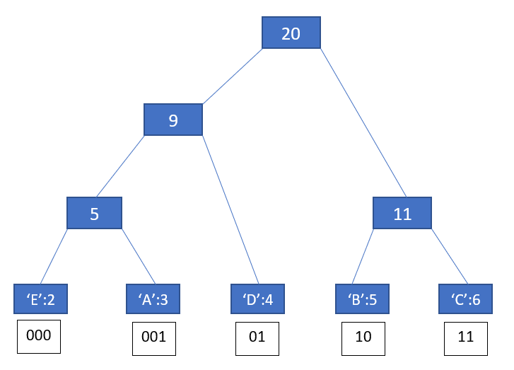
Real Life Application
Tree corresponding to the optimal variable-size prefix codes. Each internal node is labelled with the sum of the frequency of min of leaf nodes.

Slide 31
Solution
Huffman invented a Greedy Algorithm that constructs an optimal prefix code, called Huffman Code.

Slide 32
Basic Idea
We assume that C is a set of n characters and that each character c belongs to C is an object with an attribute c:freq giving its frequency. The algorithm builds the tree T corresponding to the optimal code in a bottom-up manner. It begins with a set of C leaves and performs a sequence of C - 1 “merging” operations to create the final tree. The algorithm uses a min-priority queue Q, keyed on the frequency attribute, to identify the two least-frequent objects to merge together. When we merge two objects, the result is a new object whose frequency is the sum of the frequencies of the two objects that were merged.

Slide 33
Algorithm
HUFFMAN (C)
N = |C|
Q = C
for i = 1 to n-1
allocate a new node z
z.left = x = EXTRACT-MIN(Q)
z.right = y = EXTRACT-MIN(Q)
z.freq = x.freq + y.freq
INSERT (Q, z)
Return EXTRACT-MIN(Q) // return the root of the tree

Slide 34
Time Complexity
Q is implemented as a binary min-heap. For a set C of n characters, we can initialize Q in line 2 in O(n) time using Build-Min-Heap procedure. The for loop in line 3-8 executes exactly (n-1) times, and since each heap operation requires O(log n) time, the loop contributes O(n log n) to the running time.

Slide 35
Divide and Conquer

Slide 36
Introduction
In computer science, divide and conquer is an algorithm design paradigm based on multi-branched recursion.
APPROACH
DIVIDE
CONQUER
COMBINE
The problem is divided
into number of subproblems, that are, instances of the same problem.
The sub problems are solved recursively. If the size of the sub problem is small enough.
The solution to the subproblems are combined into a general solution for the original problem

Slide 37
Introduction
This divide-and-conquer technique is the basis of efficient algorithms for all kinds of problems, such as sorting, matrix multiplication, finding the closest pair of points, syntactic analysis, and computing the discrete Fourier transform.
There are several advantages to D&C algorithm. It’s a powerful tool for conceptually solving difficult & big problems ; as all it requires is a way of breaking down the problem into smaller problems.
D&C algorithms naturally tend to make efficient use of memory cache and led to improvement in the asymptotic cost, of solving a problem.

Slide 38

Real Life Application
PROBLEM STATEMENT
Suppose that you have been offered the opportunity to invest in the Volatile Chemical Corporation. You are allowed to buy one unit of stock only one time and then sell it a later date. You are also aware of the price of the stock in the near future.
Now your goal is to maximize your profit.

Slide 39
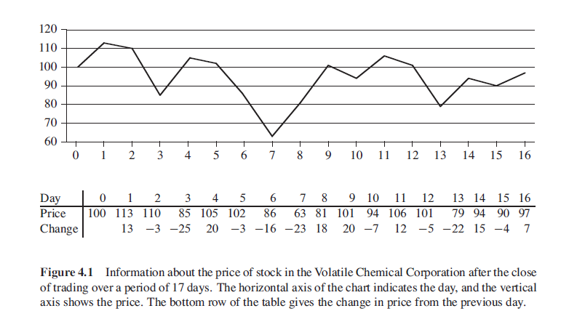
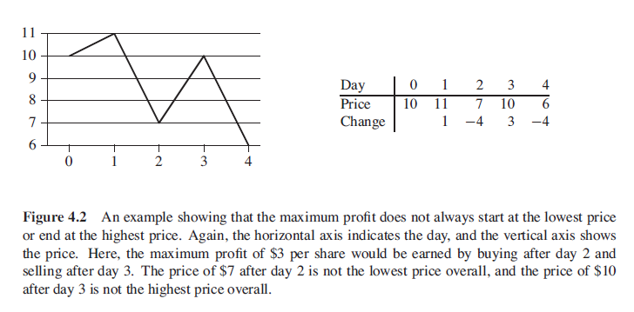
Real Life Application

Slide 40
Basic Idea
We want to find a sequence of days over which the net change from the first day to the last is maximum. Instead of looking at the daily prices, let us instead consider the daily change in price, where the change on the day i is the difference between prices after day i-1 and i. If we treat the information as an array, let’s say A, we now want to find the non-empty contiguous sub-array of A who has the largest sum.
We call this contiguous sub-array, the maximum subarray.

Slide 41
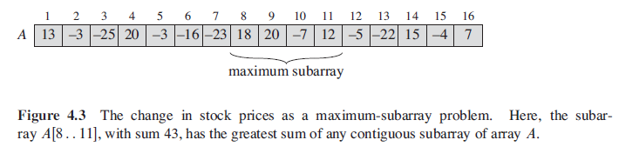
Solution
We want to find the maximum sub-array from the array A[low…….high].
According to the divide and conquer approach. We divide the array into two parts of equal sizes by evaluating mid. And consider the sub-arrays now, A[low……..mid] and A[mid+1……..high], to find the maximum sub-array.

Slide 42
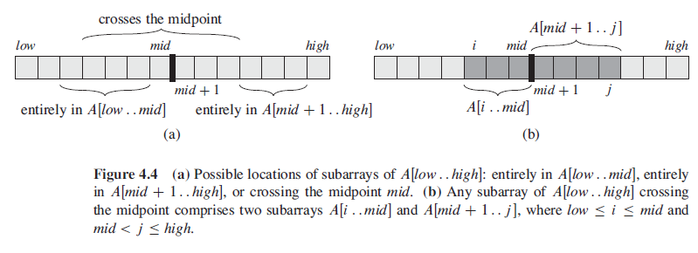
Solution
Any contagious array of A[i…..j] of A[low……high], must lie at any of the three given places :
Entirely in the sub array A[low…..mid], such that low <= i,j <= mid.
Entirely in the sub array A[mid+1…..high], such that mid+1 <= i,j <= high.
Crossing the mid point, such that low <= i <= mid < j <= high.

Slide 43
Algorithm
FIND-MAX-CROSSING-SUBARRAY (A, low, mid, high)
1 left-sum = —oo
2 sum = 0
3 for i = mid downto low
4 sum = sum + A[i]
5 if sum > left-sum
6 left-sum = sum
7 max-left = i
8 right-sum = —oo
9 sum = 0
10 for j = mid ± 1 to high
11 sum = sum + A[j]
12 if sum > right-sum
13 right-sum = sum
14 max-right = j
15 return (max-left, max-right , left-sum + right-sum)

Slide 44
FIND-MAXIMUM-SUBARRAY , low, high)
1 if high == low
2 return (low, high, A[low]) // base case: only one element
3 else mid = [(low + high)/2J
4 (left-low, left-high, left-sum) =
FIND-MAXIMUM-SUBARRAY (A , low, mid)
5 (right-low, right-high, right-sum) =
FIND-MAXIMUM-S UBARRAY (A, mid + 1, high)
6 (cross-low, cross-high, cross-sum) =
FIND-MAX-CROSS ING-SUBARRAY (A , low, mid, high)
7 if left-sum > right-sum and left-sum > cross-sum
8 return (left-low, left-high, left-sum)
9 else if right-sum > left-sum and right-sum > cross-sum
10 return (right-low, right-high, right-sum)
11 else return (cross-low, cross-high, cross-sum)

Slide 45
Backtracking

Slide 46
Introduction
Backtracking is an algorithmic-technique for solving problems recursively by trying to build a solution incrementally, one piece at a time, removing those solutions that fail to satisfy the constraints of the problem at any point of time

Slide 47
Introduction
Generally, every constraint satisfaction problem which has clear and well-defined constraints on any objective solution, that incrementally builds candidate to the solution and abandons a candidate (“backtracks”) as soon as it determines that the candidate cannot possibly be completed to a valid solution, can be solved by Backtracking.

Slide 48
Introduction
However, most of the problems that are discussed, can be solved using other known algorithms like Dynamic Programming or Greedy Algorithms in logarithmic, linear, linear-logarithmic time complexity in order of input size, and therefore, outshine the backtracking algorithm in every respect. However, a few problems still remain, that only have backtracking algorithms to solve them until now.

Slide 49
Illustration on the Subset Sum Problem
Subset sum problem is to find subset of elements that are selected from a given set whose sum adds up to a given number K. We are considering the set contains non-negative values. It is assumed that the input set is unique (no duplicates are presented).

Slide 50
Illustration on the Subset Sum Problem
Backtracking can be used to make a systematic consideration of the elements to be selected. Assume given set of 4 elements, say w[1] … w[4]. Tree diagrams can be used to design backtracking algorithms.

Slide 51
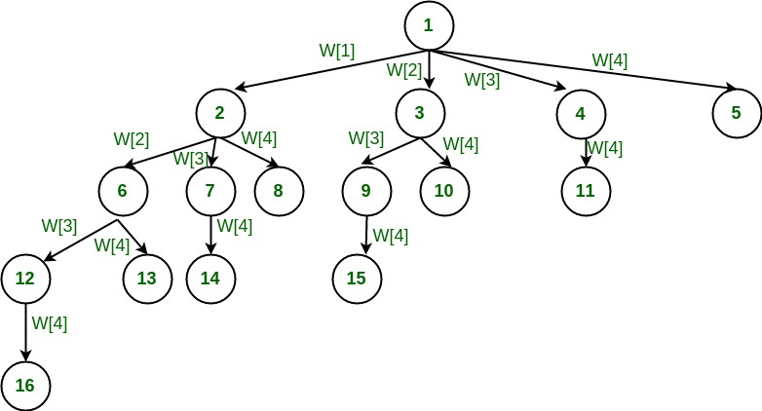
Illustration on the Subset Sum Problem
The following tree diagram depicts approach of generating variable sized tuple.

Slide 52
Illustration on the Subset Sum Problem
In the above tree, a node represents function call and a branch represents candidate element. The root node contains 4 children. In other words, root considers every element of the set as different branch. The next level sub-trees correspond to the subsets that includes the parent node. The branches at each level represent tuple element to be considered. For example, if we are at level 1, node [1] can take any value of four branches generated. If we are at level 2 of left most node, node [2] can take any value of three branches generated, and so on…

Slide 53
Illustration on the Subset Sum Problem
As we go down along depth of tree we add elements so far, and if the added sum is satisfying explicit constraints, we will continue to generate child nodes further. Whenever the constraints are not met, we stop further generation of sub-trees of that node, and backtrack to previous node to explore the nodes not yet explored. In many scenarios, it saves considerable amount of processing time.

Slide 54
Pseudo-code for the Subset Sum Problem
if(subset is satisfying the constraint)
print the subset
exclude the current element and consider next element
else
generate the nodes of present level along breadth of tree and
recur for next levels

Slide 55
Real Life Problem using Backtracking
Now, taking the Subset Sum Problem as a reference, let’s try solving a very similar problem:
Consider you have some money M. And you have to buy a list of items that you don’t have the money for. Each of the items in the list have their own unique prices. You have to buy items (not necessarily every item) such that the total cost of all the items are exactly M.
The pseudo-code and explanation is the same as given above. The code for this has been implemented in C and has been provided as a .c file (backtracking.cpp).

Slide 56
Branch and Bound

Slide 57
Introduction
Branch and bound is a systematic method for solving optimization problems.
B&B is an optimization technique that applies where the greedy method and dynamic programming fail.
However, it sometimes is much slower. It often leads to exponential time complexities in the worst case.
On the other hand, if applied carefully, it can lead to algorithms that run reasonably fast on average.

Slide 58
General Idea
The general idea of B&B is a BFS-like search for the optimal solution, but not all nodes get expanded (i.e., their children generated). Rather, a carefully selected criterion determines which node to expand and when, and another criterion tells the algorithm when an optimal solution has been found.

Slide 59
Illustration on the Job Assignment Problem
Problem Statement:
Let there be N workers and N jobs. Any worker can be assigned to perform any job, incurring some cost that may vary depending on the work-job assignment. It is required to perform all jobs by assigning exactly one worker to each job and exactly one job to each agent in such a way that the total cost of the assignment is minimized.

Slide 60
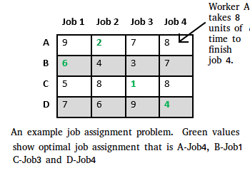
Illustration on the Job Assignment Problem

Slide 61
Illustration on the Job Assignment Problem
The search for an optimal solution can often be speeded by using an “intelligent” ranking function, also called an approximate cost function to avoid searching in sub-trees that do not contain an optimal solution. It is similar to BFS-like search but with one major optimization. Instead of following FIFO order, we choose a live node with least cost.

Slide 62
Illustration on the Job Assignment Problem
We may not get optimal solution by following node with least promising cost, but it will provide very good chance of getting the search to an answer node quickly.

Slide 63
Illustration on the Job Assignment Problem
There are two approaches to calculate the cost function:
For each worker, we choose job with minimum cost from list of unassigned jobs (take minimum entry from each row).
For each job, we choose a worker with lowest cost for that job from list of unassigned workers (take minimum entry from each column).
We will be following the first approach – taking minimum entry from each row.

Slide 64
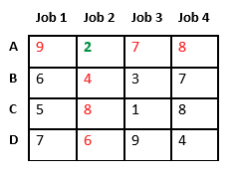
Illustration on the Job Assignment Problem
Let’s take below example and try to calculate promising cost when Job 2 is assigned to worker A.
Since Job 2 is assigned to worker A (marked in green), cost becomes 2 and Job 2 and worker A becomes unavailable (marked in red).

Slide 65
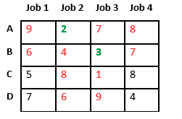
Illustration on the Job Assignment Problem
Now we assign job 3 to worker B as it has minimum cost from list of unassigned jobs. Cost becomes 2 + 3 = 5 and Job 3 and worker B also becomes unavailable.

Slide 66
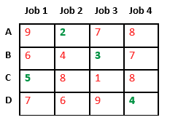
Illustration on the Job Assignment Problem
Finally, job 1 gets assigned to worker C as it has minimum cost among unassigned jobs and job 4 gets assigned to worker C as it is only Job left. Total cost becomes 2 + 3 + 5 + 4 = 14.

Slide 67
Illustration on the Job Assignment Problem
What we did above, is find the total cost if we chose A as Job 2 in the start, and consecutively assign jobs to B, C and D with least costs respectively. This cost is the total cost for when ‘ A -> 2 ’. We do this for ‘ A -> 1’, ‘ A -> 3 ’, and ‘A -> 4’ also. And we find the least total cost among these four. The least among these, will determine which job should be assigned to A.
Then we do the same by branching out A and finding the lowest cost for B, and the subsequent people.

Slide 68
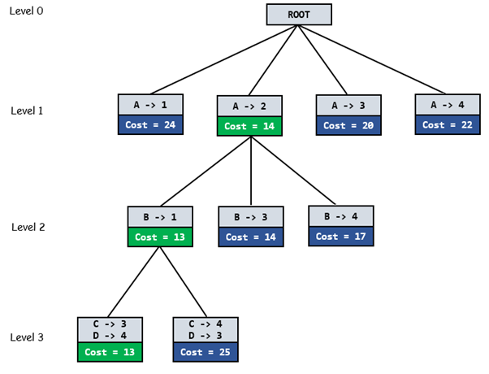
Illustration on the Job Assignment Problem

Slide 69
Algorithm for the Job Assignment Problem
// Search Space Tree Node
node
{
int job_number;
int worker_number;
node parent;
int cost;
}

Slide 70
Algorithm for the Job Assignment Problem
algorithm findMinCost (costMatrix mat[][]){
// Initialize list of live nodes(min-Heap)
// with root of search tree i.e. a Dummy node
while (true){
// Find a live node with least estimated cost
E = Least();
// The found node is deleted from the list
// of live nodes
if (E is a leaf node){
printSolution();
return;
}
for each child x of E{
Add(x); // Add x to list of live nodes;
x->parent = E; // Pointer for path to root
}
}
}

Slide 71
Algorithm for the Job Assignment Problem
findMinCost uses Least() and Add() to maintain the
list of live nodes
Least() finds a live node with least cost, deletes
it from the list and returns it
Add(x) calculates cost of x and adds it to the list
of live nodes

Slide 72
Conclusion
Branch and bound is an algorithm design paradigm which is generally used for solving combinatorial optimization problems. These problems are typically exponential in terms of time complexity and may require exploring all possible permutations in worst case. The Branch and Bound Algorithm technique solves these problems relatively quickly.

